Slide 1
SPAM CLASSIFICATION CAPSTONE PROJECT
CSA1363-THEORY OF COMPUTATION
PROJECT BY :
K.Kishore
192211912
D. Surendranadh
192211777

Slide 2

CONTENT
Introduction
01
04
02
Techniques and Algorithms
Evaluation Metrics
03
FUTURE SCOPE

Slide 3

Introduction to Spam Classification
Definition of Spam: Spam refers to unwanted, unsolicited digital communications, typically sent in bulk via email.
Importance of Spam Classification: Effective spam classification is crucial for reducing unwanted emails, protecting users from phishing, and enhancing overall cyber security.
Overview of Spam Classification Techniques: Techniques range from simple rule-based filters to complex machine learning algorithms that adapt to new spam patterns.
Photo by Stephen Phillips - Hostreviews.co.uk on Unsplash

Slide 4
Techniques and Algorithms
Rule-based Filters: Early spam filters relied on manually crafted rules to detect spam based on keywords, sender addresses, and message patterns.
Machine Learning Approaches: Modern spam filters use machine learning algorithms to analyze email features and classify messages based on learned patterns from labeled datasets.
Deep Learning Models: Deep learning techniques, such as neural networks, offer advanced capabilities in understanding complex spam patterns, enhancing accuracy and adaptability.
Photo by Stephen Phillips - Hostreviews.co.uk on Unsplash

Slide 5

Evaluation Metrics
Accuracy: Measures the proportion of correctly identified emails (both spam and non-spam) out of the total emails.
Precision, Recall, F1-Score: Precision: Proportion of true positives out of all predicted positives. Recall: Proportion of true positives out of all actual positives. F1-Score: Harmonic mean of precision and recall.
ROC and AUC: ROC (Receiver Operating Characteristic) curve plots true positive rate against false positive rate. AUC (Area Under Curve) indicates the model's overall performance.
Photo by Isaac Smith on Unsplash

Slide 6
CODE
/#include <stdio.h>
#include <string.h>
#include <stdbool.h>
bool isSpam(const char *emailContent) {
// List of spam keywords
const char *spamKeywords[] = {

Slide 7
"winner", "free", "money", "prize", "click here", "urgent", "buy now",
"limited time offer", "cash", "guarantee", "loan", "risk-free", "unsubscribe"
};
size_t numKeywords = sizeof(spamKeywords) / sizeof(spamKeywords[0]);

Slide 8
for (size_t i = 0; i < numKeywords; ++i) { if (strstr(emailContent, spamKeywords[i]) != NULL) { return true; } } return false; int main() { char emailContent[1000]; printf("Enter the email content: "); fgets(emailContent, sizeof(emailContent), stdin); if (isSpam(emailContent)) { printf("This email is classified as spam.\n"); } else { printf("This email is not classified as spam.\n"); } return 0; }

Slide 9
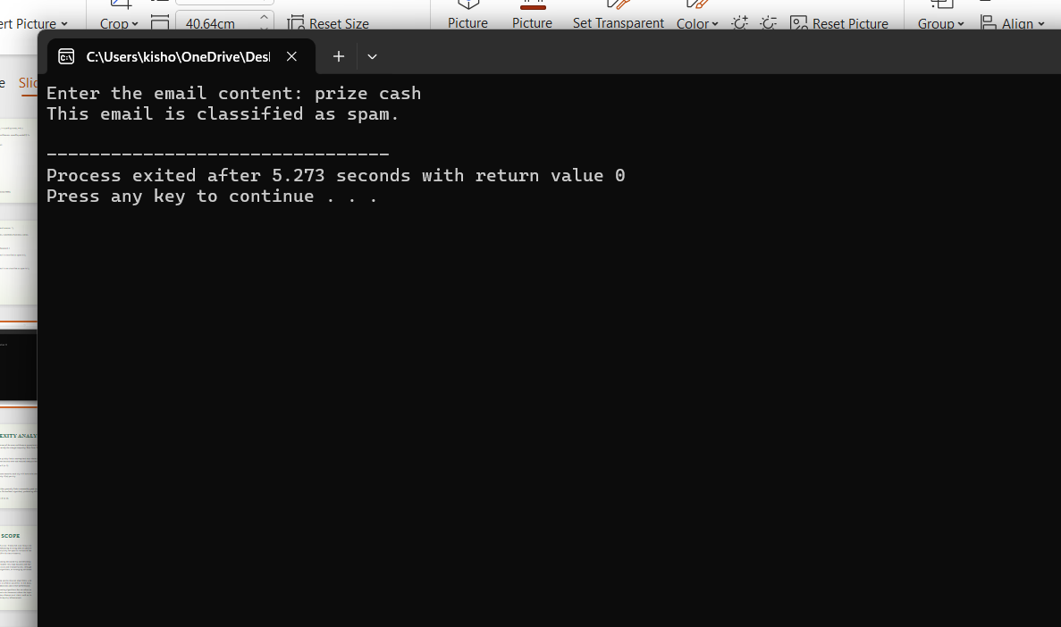

Slide 10
FUTURE SCOPE
Email service providers can integrate the model to improve their spam filters.
- Organizations can use the tool to safeguard their communication channels from spam.
- Individual users can utilize the application to filter out unwanted emails.
- Enhancing cybersecurity by identifying phishing and malware-laden emails.
Procedures and Methodology:
➢Automated Candidate Screening: Quickly analyze resumes to identify relevant ski ls, experience, and qualifications, saving time in the initial stages of recruitment

Slide 11


